Slide 1


Manifold Sculpting
Giovanni Canali
22/12/2023

Slide 2
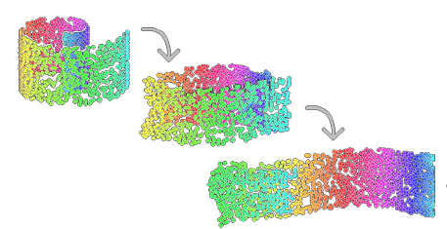
Introduction
Two-step process:
Tranform data so that as much information as possible will survive projection.
Project data in a lower dimensional space.

Slide 3
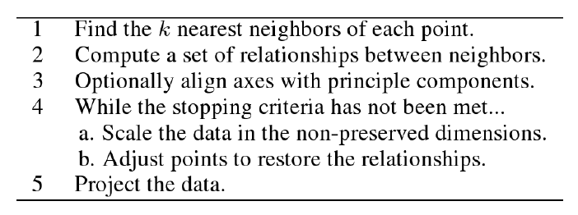
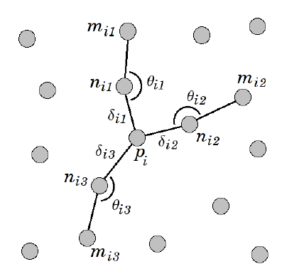
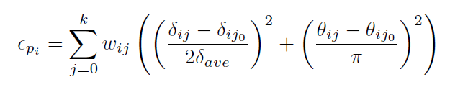
Pseudocode
2: distances and angles with most collinear elements.
4.b: error used to evaluate restoration of the relationships.

Slide 4
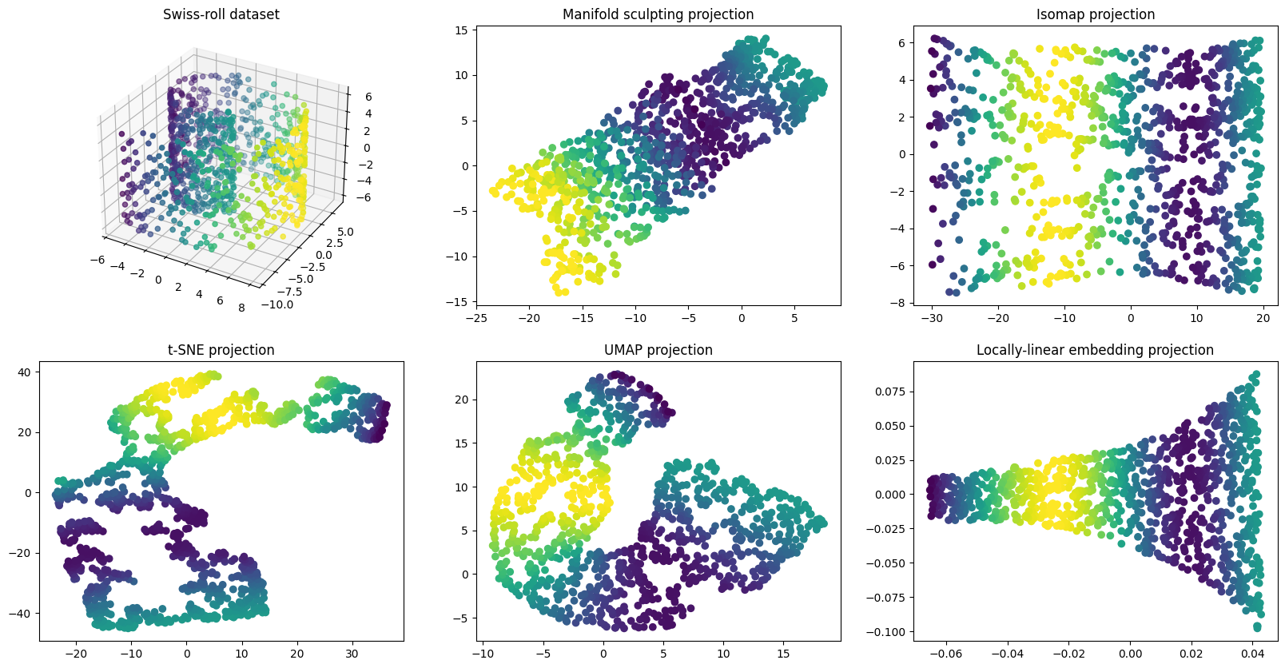
Swiss-roll dataset

Slide 5
Swiss-roll dataset

Slide 6
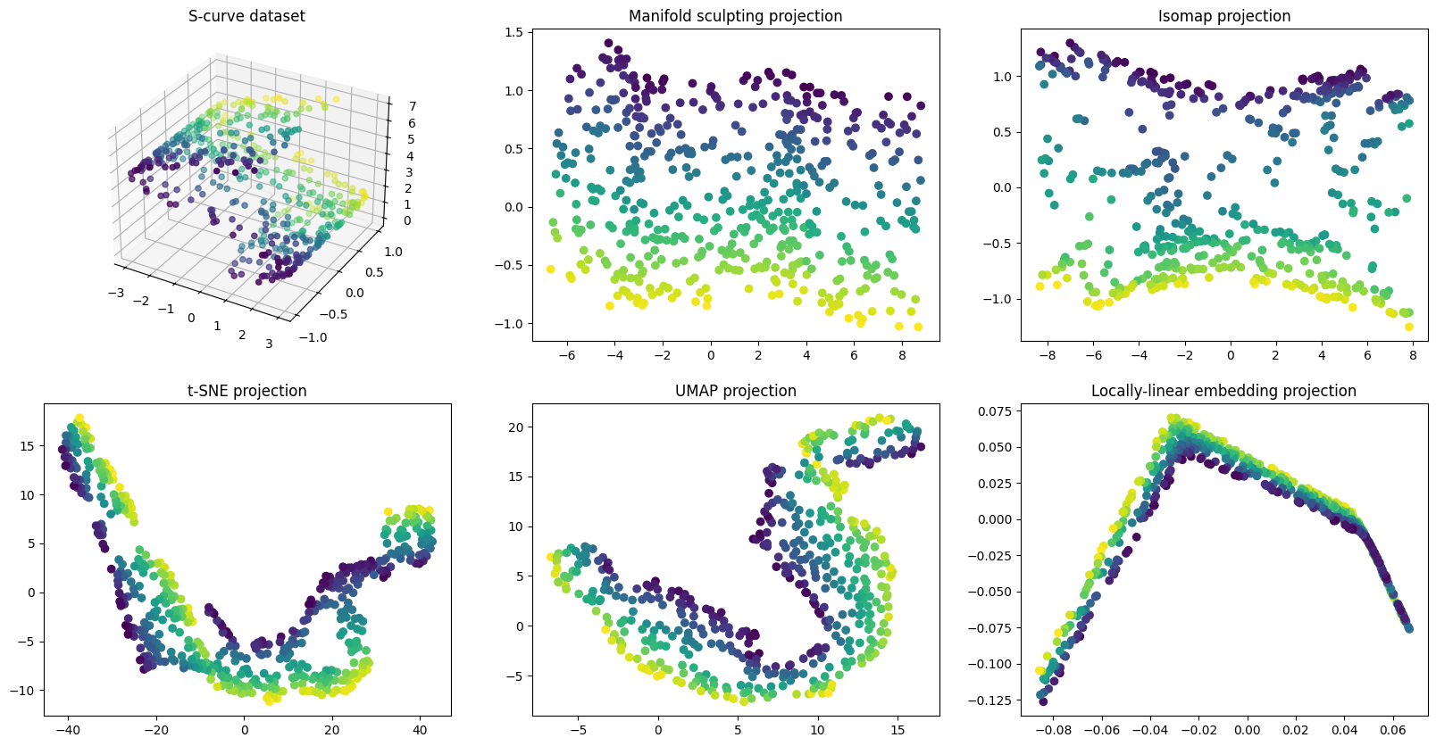
S-curve dataset

Slide 7
Other applications?

